Slide 1
Module 1.2
Software Process

Slide 2
Steps involved in Software Development
Identification of Problem
Problem Definition
Exploring approach(s) to solve the problem
Penning down/ finalizing the approach; listing the steps
Development
Testing
Deployment
Maintenance
These steps are iterative and some of them run parallel.

Slide 3
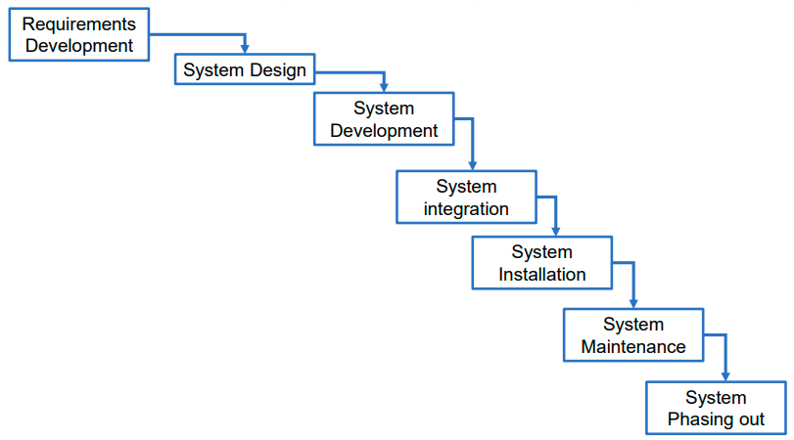
Processes of System Engineering

Slide 4
Software Process
Characterized by:
Common process framework established by defining a small number of framework activities that are applicable to all software projects, regardless of their size or complexity
Consists:
Framework Activities which include:
Task sets, represented by Tasks, Milestones & Deliverables , SQA
Umbrella Activities

Slide 5
The Software Process
Software process also known as methodology, is a set of related activities that leads to the production of the software activities may involve the development of the software scratch or modifying existing system.
A process is a collection of activities, actions, and tasks that are performed when some work product is to be created.
An activity strives to achieve a broad objective (e.g., communication with stakeholders) and is applied regardless of the application domain, size of the project, complexity of the effort.
An action (e.g., architectural design) encompasses a set of tasks that produce a major work product (e.g., an architectural model).
A task focuses on a small, but well-defined objective (e.g., conducting a unit test) that produces a tangible outcome

Slide 6
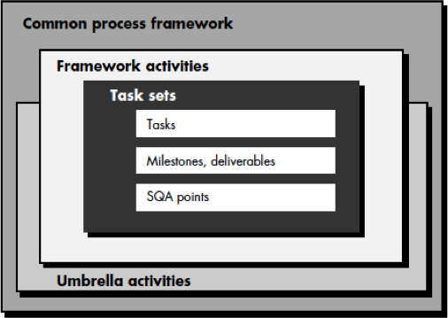
Process Framework activities
70

Slide 7
The Software Process
A generic process framework for software engineering encompasses five activities:
Communication: communicate with customer to understand objectives and gather requirements
Planning: creates a “map” defines the work by describing the tasks, risks and resources, work products and work schedule.
Modeling: Create a “sketch”, what it looks like architecturally, how the constituent parts fit together and other characteristics.
Construction: code generation and the testing.
Deployment: Delivered to the customer who evaluates the products and provides feedback based on the evaluation.

Slide 8
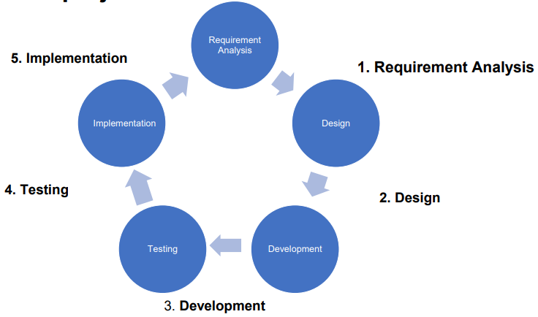
Activities performed in life cycle of a Software Development projects (SDLC-Software Development Life Cycle)

Slide 9
The Software Process
Umbrella Activities
Complement the five process framework activities and help team manage and control progress, quality, change, and risk.
Software project tracking and control: assess progress against the plan and take actions to maintain the schedule.
Risk management: assesses risks that may affect the outcome and quality.
Software quality assurance: defines and conduct activities to ensure quality.
Technical reviews: assesses work products to uncover and remove errors before going to the next activity.

Slide 10
The Software Process
Umbrella Activities
Measurement: define and collects process, project, and product measures to ensure stakeholder’s needs are met.
Software configuration management: manage the effects of change throughout the software process.
Reusability management: defines criteria for work product reuse and establishes mechanism to achieve reusable components.
Work product preparation and production: create work products such as models, documents, logs, forms and lists.

Slide 11
Metrics, Measures & Indicators
Measures is a number or a quantity that records a directly observable value or performance.
A measurement is a manifestation of the size, quantity, amount, or dimension of a particular attribute of a product or process.
Metrics represent the different methods employed to understand change over time across a number of dimensions or criteria.
It is often used as a catch all terms to describe the method used to measure something, the resulting values obtained from measuring, as well as a calculated or combined set of measures.
Indicators are qualitative or quantitative factors or variables that provide a simple and reliable meaning to express achievement, the attainment of a goal, or the results stemming from a specific change

Slide 12
Classification of Software Measurement
There are 2 types of software measurement:
Direct Measurement:
In direct measurement, the product, process, or thing is measured directly using a standard scale.
EX. LOC, Execution time, No. of Errors etc.
Indirect Measurement:
In indirect measurement, the quantity or quality to be measured is measured using related parameters i.e. by use of reference.
Ex. Code complexity, customer satisfaction etc.

Slide 13
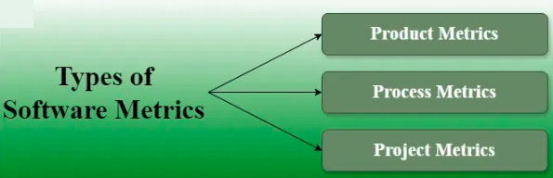
Software Metrics
Product Metrics:
Product metrics are used to evaluate the state of the product, tracing risks and undercover prospective problem areas.
The ability of the team to control quality is evaluated.
Examples include lines of code, complexity, code coverage, defect density, and code maintainability index.

Slide 14
Process Metrics:
Process metrics pay particular attention to enhancing the long-term process of the team or organization.
These metrics are used to optimize the development process and maintenance activities of software.
Examples include effort variance, schedule variance, defect injection rate, and lead time (how long it takes to complete a process from beginning to end.).
Project Metrics:
The project metrics describes the characteristic and execution of a project.
Examples include effort estimation accuracy, schedule deviation, cost variance, and productivity.
Usually measures-
Number of software developer
Staffing patterns over the life cycle of software
Cost and schedule
Productivity

Slide 15
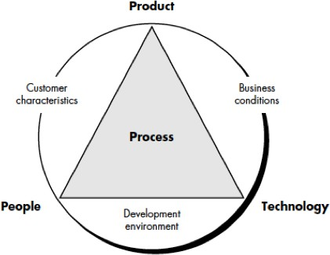
Process Metrics
Pertain to Process Quality
Used to measure the efficiency and effectiveness of various processes
Used for strategic purpose

Slide 16
Software Process Metrics
Software process metrics can provide significant benefit as an organization works to improve its overall level of process maturity.
Software metrics etiquette are:
Use common sense and organizational sensitivity when interpreting metrics data.
Provide regular feedback to the individuals and teams who collect measures and metrics.
Don’t use metrics to appraise individuals.
Work with practitioners and teams to set clear goals and metrics that will be used to achieve them.
Never use metrics to threaten individuals or teams.
Metrics data that indicate a problem area should not be considered “negative.” These data are merely an indicator for process improvement.
Don’t obsess on a single metric to the exclusion of other important metrics These steps are iterative and some of them run parallel

Slide 17
Software Process Metrics
Statistical software process improvement (SSPI):
the collection and use of process metrics, the derivation of simple indicators gives way to a more rigorous approach.
SSPI uses software failure analysis to collect information about all errors and defects encountered as an application, system, or product is developed and used.
Failure analysis works in the following manner:
All errors and defects are categorized by origin (e.g., flaw in specification, flaw in logic, non-conformance to standards).
The cost to correct each error and defect is recorded.
The number of errors and defects in each category is counted and ranked in descending order.
The overall cost of errors and defects in each category is computed.
Resultant data are analyzed to uncover the categories that result in highest cost to the organization.
Plans are developed to modify the process with the intent of eliminating

Slide 18
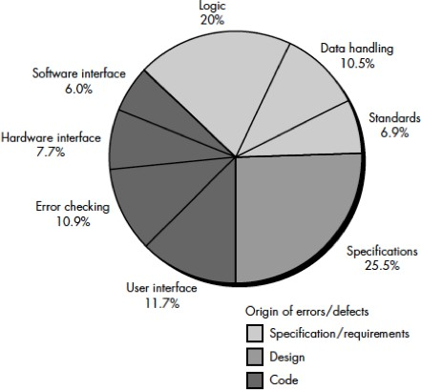
Failure Analysis

Slide 19
Process Maturity
Software Engineering Institute (SEI) has developed a comprehensive model predicated on a set of software engineering capabilities that should be present for an organization when the organization reaches different levels of process maturity.

Slide 20
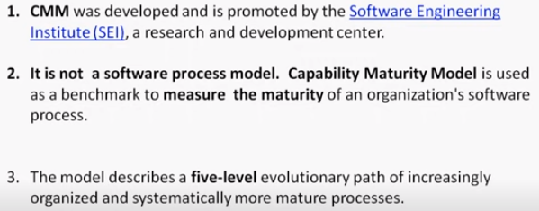
Capability Maturity Model (CMM)
Five levels usually it is termed as
Capability Maturity Model (CMM) Levels

Slide 21
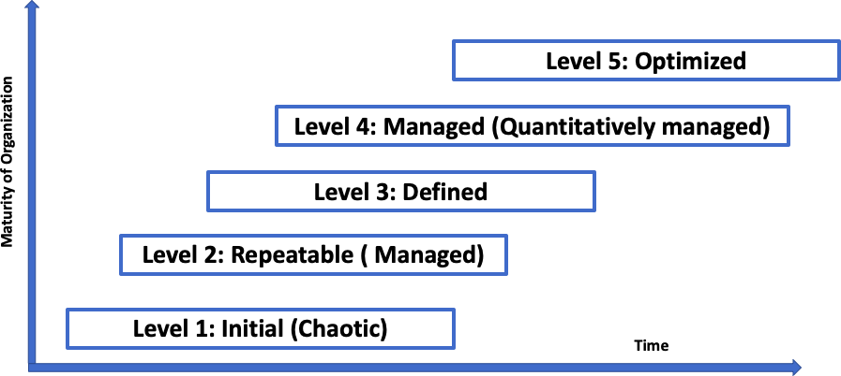
CMM Levels
Continuous process improvement
Process standardization

Slide 22
CMM Levels
Level 1: Initial. The software process is characterized as ad hoc and occasionally even chaotic. Few processes are defined, and success depends on individual effort.
Level 2: Repeatable (Managed). Basic project management processes are established to track cost, schedule, and functionality. The necessary process discipline is in place to repeat earlier successes on projects with similar applications.
Level 3: Defined. The software process for both management and engineering activities is documented, standardized, and integrated into an organization-wide software process. All projects use a documented and approved version of the organization's process for developing and supporting software. This level includes all characteristics defined for level 2.
Level 4: Managed (Quantitively managed). Detailed measures of the software process and product quality are collected. Both the software process and products are quantitatively understood and controlled using detailed measures. This level includes all characteristics defined for level 3.
Level 5: Optimizing. Continuous process improvement is enabled by quantitative feedback from the process and from testing innovative ideas and technologies. This level includes all characteristics defined for level 4.

Slide 23
Key Process Areas (KPA)
The SEI has associated key process areas (KPAs) with each of the maturity levels which describe those software engineering functions (e.g., software project planning, requirements management) that must be present to satisfy good practice at a particular level.
Characteristics Of KPAs
Goals—the overall objectives that the KPA must achieve.
Commitments—requirements (imposed on the organization) that must be met to achieve the goals or provide proof of intent to comply with the goals.
Abilities—those things that must be in place (organizationally and technically) to enable the organization to meet the commitments.
Activities—the specific tasks required to achieve the KPA function.
Methods for monitoring implementation—the manner in which the activities are monitored as they are put into place.
Methods for verifying implementation—the manner in which proper practice for the KPA can be verified.

Slide 24
KPAs of CMM Level 2
Process maturity level 2 (Repeatable /managed)
Goals, Commitments, Abilities, Activities, Methods for monitoring implementation, Methods for verifying implementation
Software configuration management
Software quality assurance
Software subcontract management
Software project tracking and oversight
Software project planning
Requirements management

Slide 25
KPAs of CMM Level 3
Process maturity level 3 (Defined)
Goals, Commitments, Abilities, Activities, Methods for monitoring implementation, Methods for verifying implementation achieved through:
Peer reviews
Intergroup coordination
Software product engineering
Integrated software management
Training program
Organization process definition
Organization process focus

Slide 26
KPAS of CMM Level 4 & 5
Process maturity level 4 Managed (Quantitatively managed)
Goals, Commitments, Abilities, Activities, Methods for monitoring implementation,
Methods for verifying implementation
Software quality management
Quantitative process management
Process maturity level 5 (Optimized)
Process change management
Technology change management
Defect prevention

